Slide 1

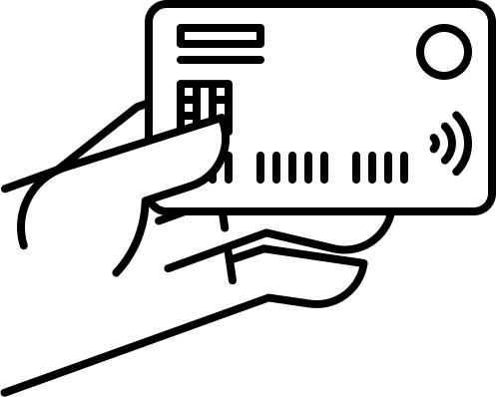
Credit Card approval system
Presented by: Aryan Puri
Intern, Clevered

Slide 2
1 | Introduction: Abit about myself
2 | Journey with Clevered
3 | About the Project :- Credit Card Approval System
4 | Project Visualization :- Credit Card Approval System
5 | Examples: The input it takes:- Credit Card Approval System
6 | Contact Details and Conclusion
Table
of
Contents

Slide 3
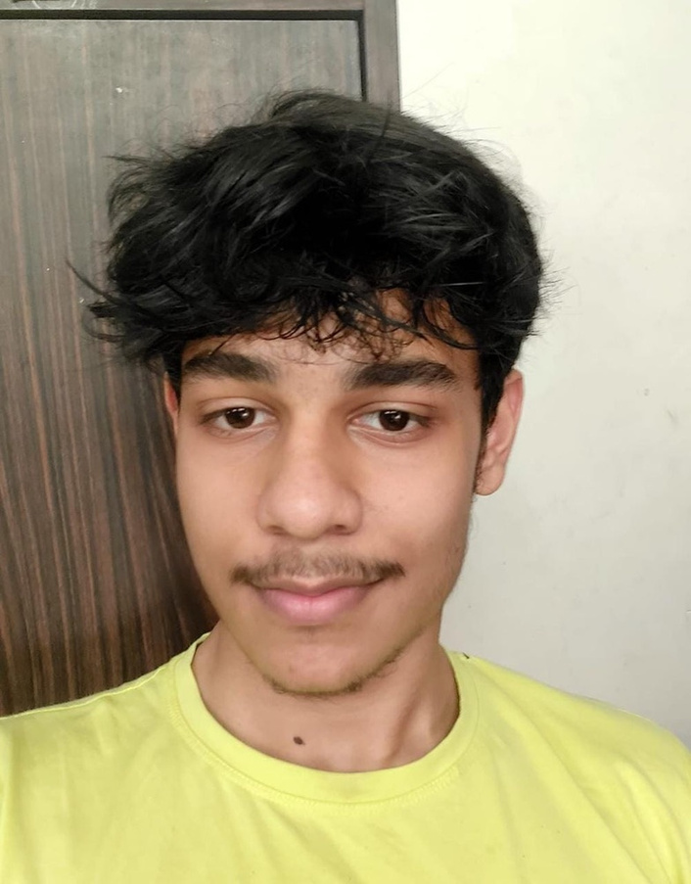
Abit about About Myself
Name: Aryan Puri
Age: 16
Occupation:
Student, Grade 11 Cbse
Location:
New Delhi, India
I am currently studying in St. Columba’s school in grade 11. I had opted in to take science to further enhance my skills and also plan on learning a bit about augmented reality in the coming years. I I enrolled in CleverEd to understand the workings of AI and how we can utilize deep learning to explore datasets ,how we can use deep learning ,finding neural networks etc.
Personal Characteristics: | Hobbies and Interests:
Willing to learn Solution-oriented | Reviewing tech Acting Computer Science Designing
Goals: | Currently thinking about
To understand and work on my future goals properly before i step out of school.
Analysing the potential impact of quantum computing and interested to also understanding about quantum computing and AGI

Slide 4

Journey with Clevered
Avishek Sir's dedication and support were instrumental in developing our project Avishek sir always stayed by our side no matter how late it got, never stepped down on us, and was always ready to help us understand the project and work on it. Sir always explained complex concepts in a way that made them easy to understand no matter how long it took. It wouldn't have been possible to do this project without him.I would also like to thank my parents, Dr. ken and everyone who made it possible to provide me with this project

Slide 5
About the
Project:- Credit Card Approval System
Description
It is a projct developed which helps the user by predicting the likelihood of the person getting a credit card based on various parameters.
Organizing data
Building and checking the accuracy model
Plotting Features (most important such as income years employed etc)
Forming the front-end code
The
User
Interface
of the
Project
The main aim of this project was to declutter the data and convert it into usable form (string to float form) and then train the data accordingly
The dataset on which the model was formed and trained was provided by kaggle

Slide 6
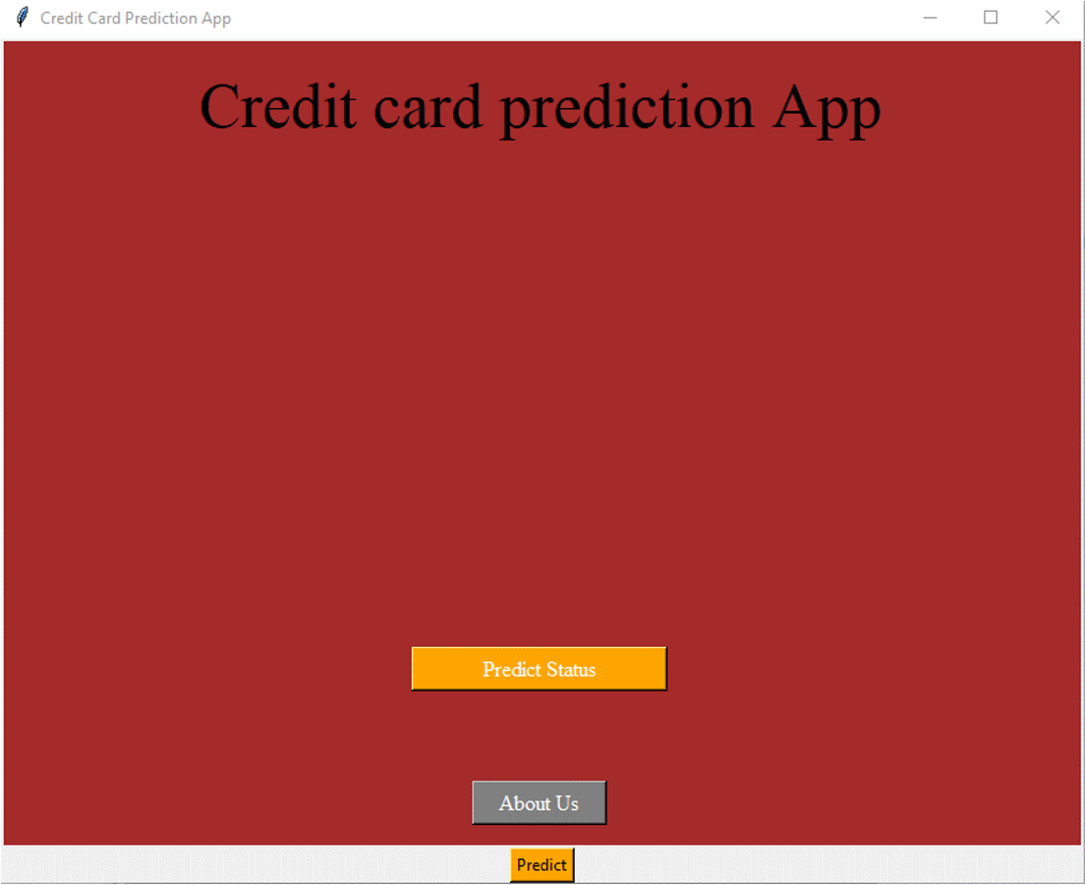
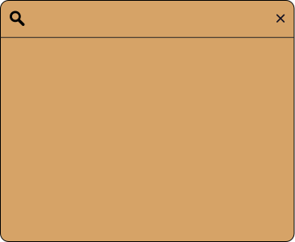
Visual view of the project:
The User Interface
To start the prediction
process ( Front end made using Tkinter)
This is the home screen menu which opens up when the program runs
credits

Slide 7

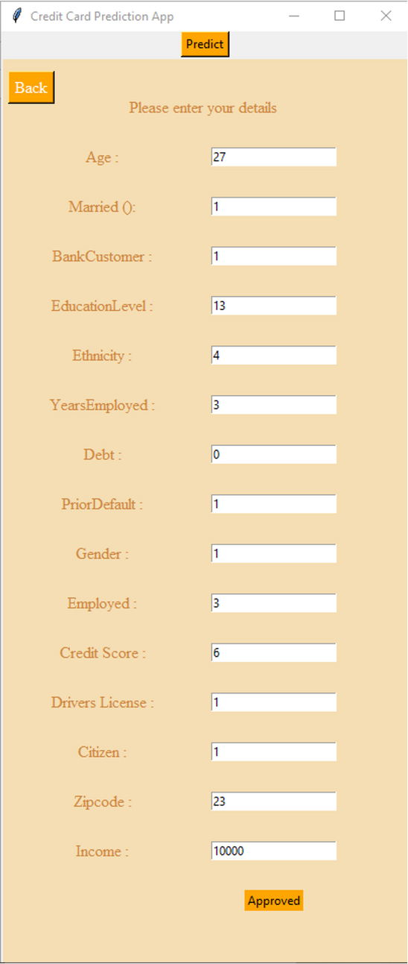
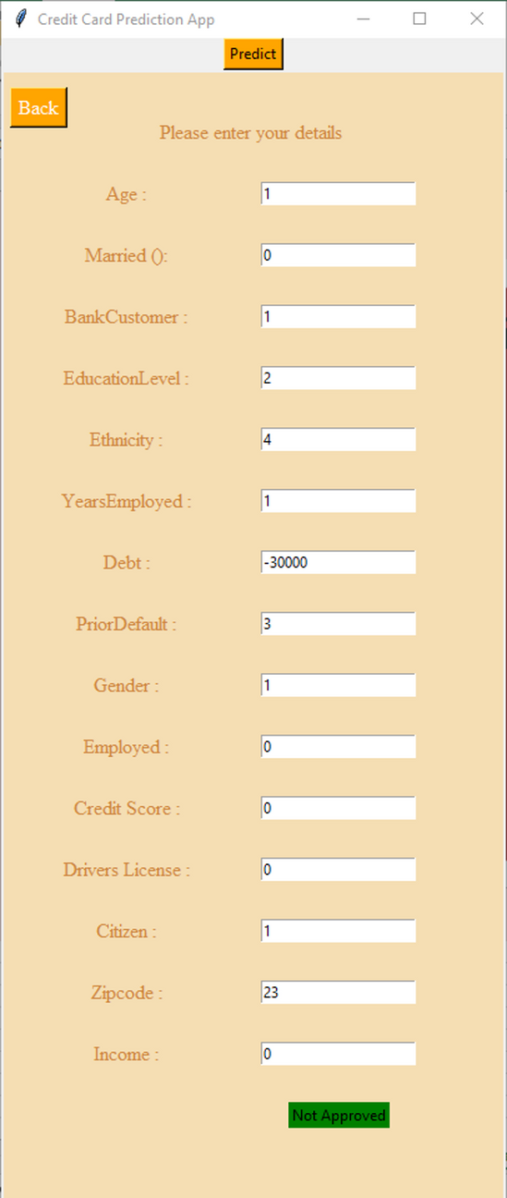

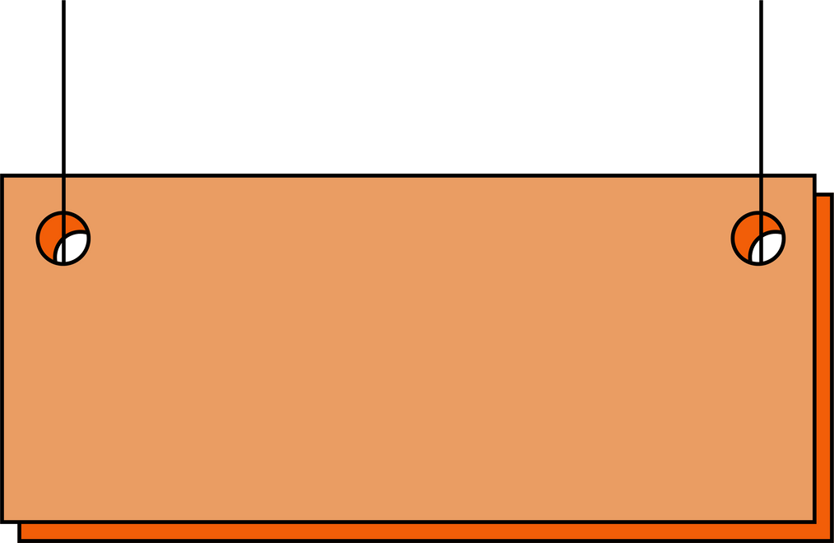
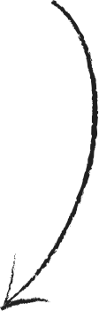
Examples:-
the input it takes
the parameters its takes for assesment by the trained model(only in float/ integer values)
using the input data and then using a random-forest classifier it suggest it would be approved with the above mentioned credentials
using the input data and then using a random-forest classifier it suggest it would not be approved with the above mentioned credentials

Slide 8

with thanks
I would thank everyone present here who were a part of and who went through and understood my project.
For any queries, feel free to contact :) :-
aryanpuri07@gmail.com

